Slide 1

Blockchains
& Distributed Ledgers
Lecture 09
Aggelos Kiayias
Slide credits: AK, Michele Ciampi, Dimitris Karakostas

Slide 2
Security critical computations
How to obtain the output of a security critical computation
Deterministic with public inputs?
Repeat multiple times and consensus can be reached about its output
Example: blockchain systems with smart contracts
What if it is probabilistic with public inputs?
Coin flipping protocol
What if it uses private data?
Secure Multiparty Computation (MPC)

Slide 3
Secure Multiparty Computation and Applications
Sharing responsibility for signatures and cryptographic keys
Secret sharing
Security critical computations
Coin flipping and verifiable secret-sharing
Secure multiparty computation (MPC)
Fair swaps and fair MPC

Slide 4
Secret sharing

Slide 5
Overarching question
How to protect security critical operations?
Key idea: share responsibility and somehow tolerate faulty participants
Cryptographic keys?
Cryptocurrency addresses?
Computations?
What about computations on private data?

Slide 6
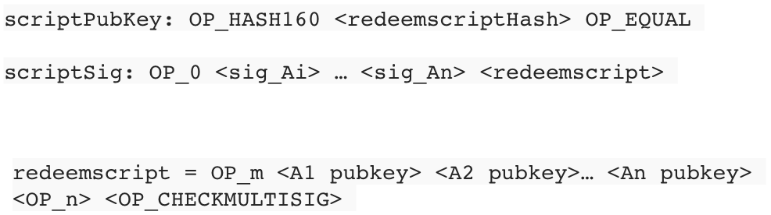
Multi-sig transactions
Multi-sig: a tx that can be redeemed if n parties sign it
A payment to a script (P2SH) can facilitate a multi-signature transaction

Slide 7
Secret-Sharing
Main question:
How to share a secret s to n shareholders so that:
Any subset including t of them can recover the secret
Any subset including less than t of them knows nothing about the secret
Relative questions:
Can we solve this for any n and t <= n?
What is the relation between the size of s and the size of each share?

Slide 8
Finite fields
Finite sets equipped with two operations, behaving similarly to addition and multiplication over the real numbers (which is an infinite field)
Finite fields exist with number of elements equal to p^{k}, for:
any prime number p
any positive integer k
Example. A binary finite field {0, 1} with:
* 0 1
0 0 0
1 0 1
(a+b) mod 2
(a*b) mod 2
+ 0 1
0 0 1
1 1 0

Slide 9
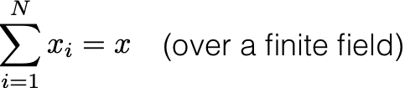
Secret-Sharing over a finite field
Consider a secret x and N random values, subject to the constraint:
This is called (additive) secret-sharing
Knowledge of any N-1 values cannot be used to infer any information about x

Slide 10
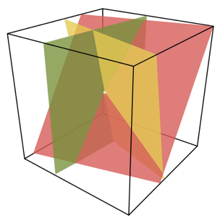
Analysis
Example: binary field
If you hold only N-1 values [x₂, …, x_{N}]:
Two unknowns: x₁, s
One equation: x₁ + x₂ + … + x_{N} = s
s cannot be undetermined
s = 0 + x₂ + … + x_{N} (if x₁ = 0)
s = 1 + x₂ + … + x_{N} (if x₁ = 1)

Slide 11
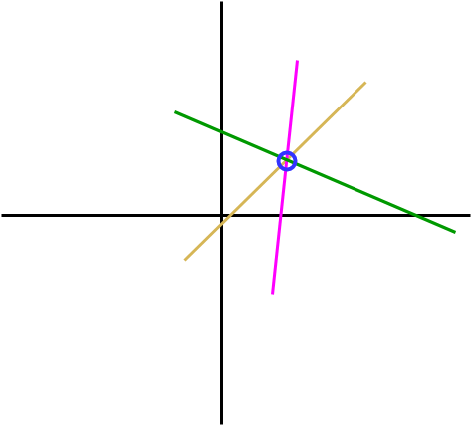
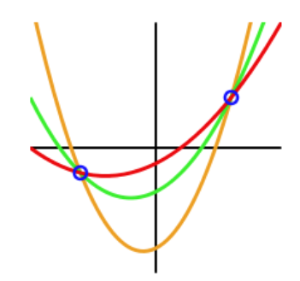
Generalisation t-out-of-n
Consider a polynomial of degree d: p(x) = a₀ + a₁x + … + a_{d} x^{d}
Any d+1 points of the polynomial completely determine it
With d or less points, at least one degree of freedom remains
p cannot be fully determined
We can use that idea to solve secret-sharing for any t, n

Slide 12
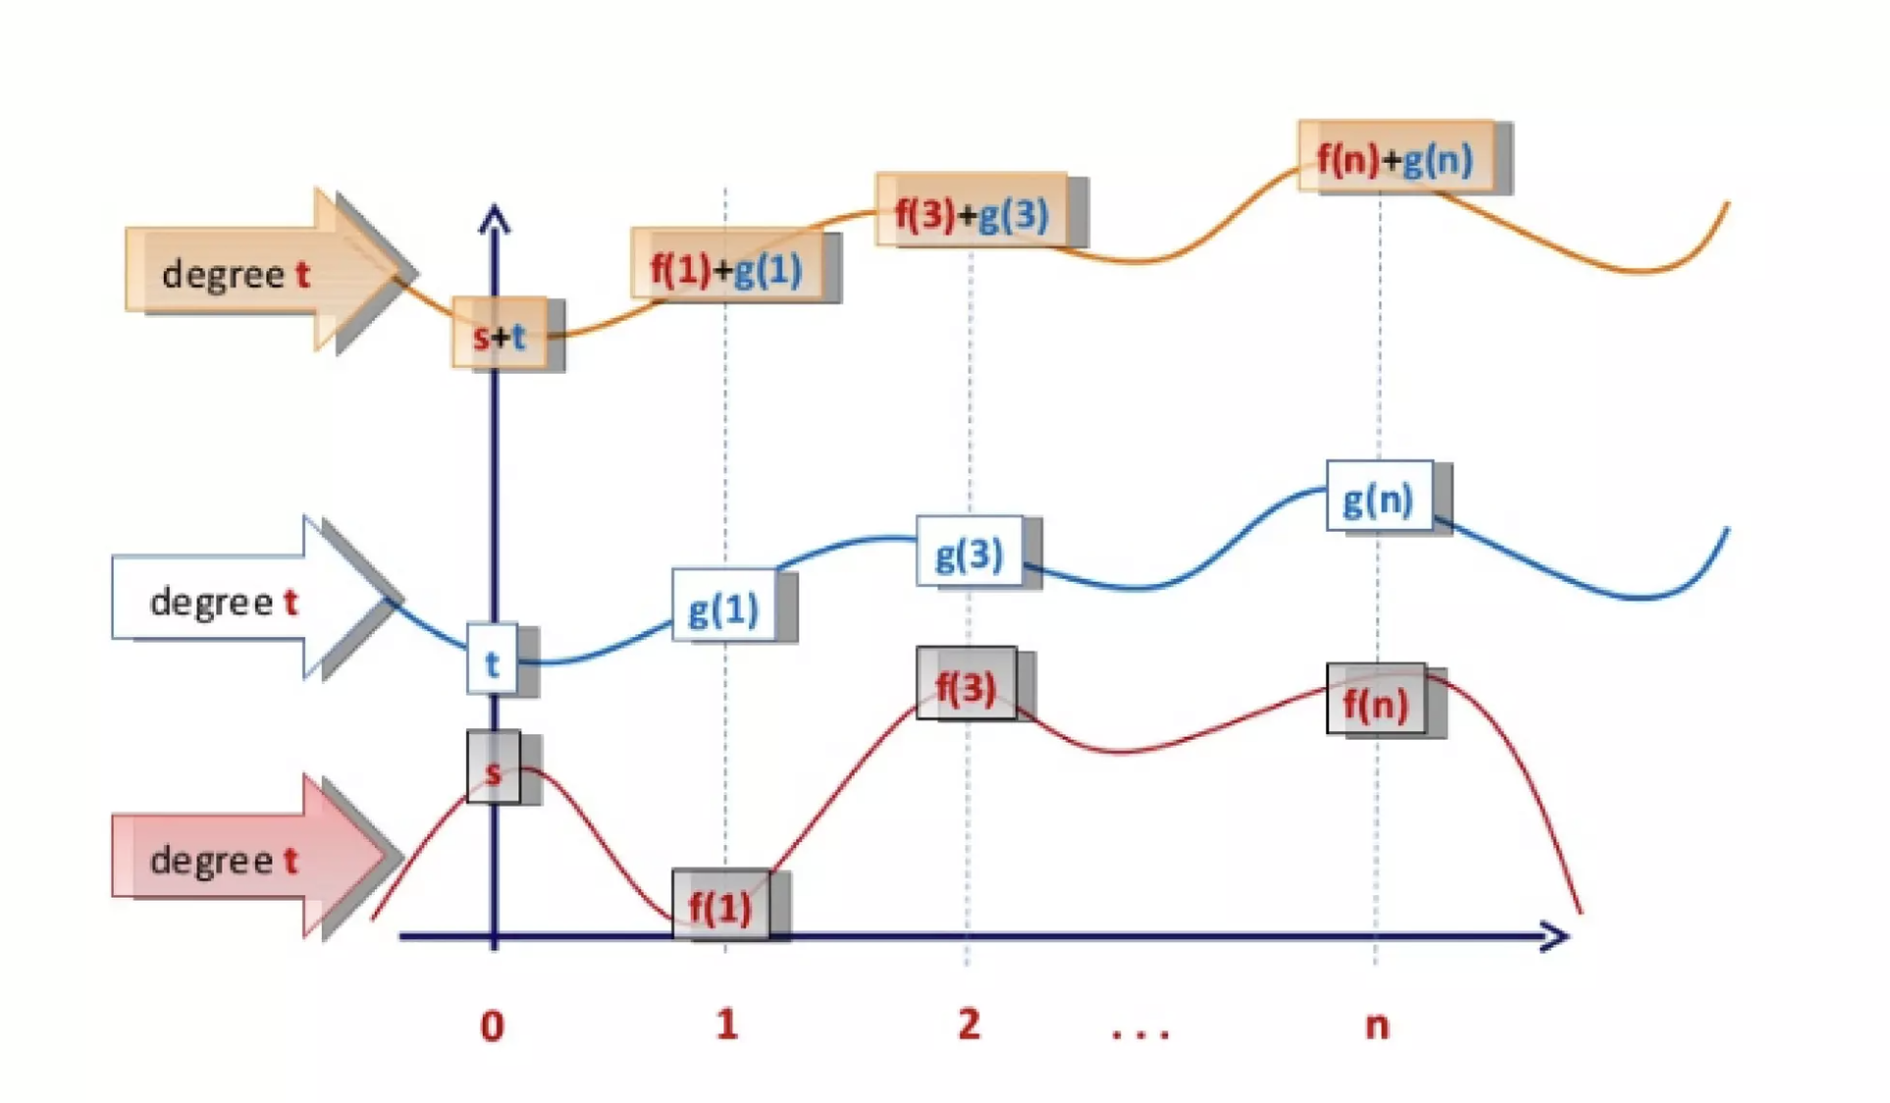
Generalisation t-out-of-n

Slide 13
Example
5 parties
Polynomials of degree 2
Any three parties (who hold 3 points) can interpolate such polynomials
Any two parties have no information about the shared secret

Slide 14
Secret-sharing cryptographic keys
Using polynomial secret-sharing, a cryptographic key can be split to multiple shareholders
Each shareholder gets a point on the plane
The secret/key is the solution to the polynomial problem
Additional points to consider:
How should the value of t be determined:
in comparison to d?
in comparison to n?
To engage in the cryptographic operation, is it necessary to reconstruct the original key?
How to accomodate an evolving set of shareholders?

Slide 15
Distributed Randomness Generation

Slide 16


$
b ← {0, 1}

Slide 17
Application: coin-flipping
Alice and Bob want to flip a coin remotely
output a bit uniformly at random
Alice doesn’t trust Bob and vice versa
neither Alice nor Bob should be able to bias the bit choice

Slide 18
Application: coin-flipping
Alice and Bob want to flip a coin remotely
output a bit uniformly at random
Alice doesn’t trust Bob and vice versa
neither Alice nor Bob should be able to bias the bit choice
Solution:
Alice commits to a random coin
Bob commits to a random coin
Alice and Bob open the commitments
Output = XOR of (committed) values
Consider:
Can the situation be improved in an N party coin flip?
What about when >N/2 parties are honest?
How do you deal with (selective) aborts?

Slide 19
A first step towards multi-party coin flipping
Each player commits to their coin (publicly)
Each player publishes a secret-sharing of the opening to their commitment
Any subset of at least (N/2 + 1) players can reconstruct the opening
Shares should be encrypted with the respective public-keys of the parties
If some parties abort the protocol: assuming that a subset of >N/2 parties continue, they can recover the share and terminate
Any number of parties up to N/2 cannot gain any advantage over the honest parties

Slide 20
What if some parties announce incorrect shares?
A secret cannot be retrieved from incorrect shares
Selective aborts possible, as remaining parties cannot reconstruct the secret
Possible solution: require that all commitments open at the end irrespectively of aborts
deviating players will be caught, but still have the option to selectively abort if they wish
other parties will only know of the abort when it is too late
One possible approach: issue monetary penalties to those that abort

Slide 21
Publicly Verifiable Secret-sharing (PVSS)
The dealer creates shares that are distributed in encrypted form
The shares can be publicly verified as correct
Verifiability should not leak information about the secret
PVSS enables parties to detect improper share distribution at the onset
Protocol can still be aborted, but any abort would be independent of the (random) coin!

Slide 22
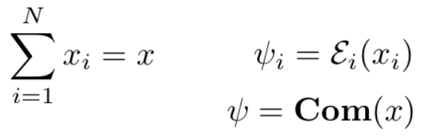
PVSS Design Challenges
Assuming:
Verify that the value encrypted in ψ_{i} satisfies the equation w.r.t. the values encrypted in ψ
This problem can be solved using a zero-knowledge proof

Slide 23
Secure MPC

Slide 24
Secure Multiparty Computation
(Secure) Multiparty Computation (MPC)
Parameterized by function f
A set of n parties P_{i} contribute inputs x₁, x₂, …, x_{n}
At the end of the protocol they compute f(x₁, x₂, …, x_{n})
Everyone receives output f(x₁, x₂, …, x_{n})
No party except P_{i} obtains information about x_{i}

Slide 25
MPC Construction Idea
Consider three roles
Input providers
Processors
Output-receivers
Input providers secret-share their input to the processors
Additive secret-sharing
Pr₁
Pr₂
s_{1,1}
s_{1,2}
s_{2,1}
s_{2,2}
s_{3,1}
s_{3,2}
IP₁
IP₂
IP₃

Slide 26
MPC Construction Idea
Any function f can be expressed as a Boolean circuit
Fixed-size input
Upper-bound on number of steps (circuit depth)
Example: any boolean function can be implemented as a combination of NAND gates
XOR, AND, NOT gates
Arithmetic representation of gates
AND: Input: a, b; Output: (a*b) mod 2
XOR: Input: a,b; Output: (a+b) mod 2
NOT: Input: a; Output: (1+a) mod 2
Each processor executes the circuit with their shares as input
How to implement the gates s.t. operations on shares, when combined, produce the correct aggregate output?

Slide 27
MPC Construction Idea, Example
s₁
s₂
s₃
s₄
XOR
NOT
AND
(s₁+s₂) mod 2
(1+s₃) mod 2
(s₃*s₄) mod 2
AND
XOR
f
...
...
XOR
...
NOT
s_{out}

Slide 28
MPC Construction Idea, Example
1
0
1
1
XOR
NOT
AND
1
0
1
AND
XOR
f
0
1
XOR
1
NOT
0

Slide 29
MPC Construction Idea, Example
s_{1,1}
s_{2,1}
s_{3,1}
s_{4,1}
XOR
NOT
AND
?
?
?
AND
XOR
f
XOR
NOT
s_{out}

Slide 30
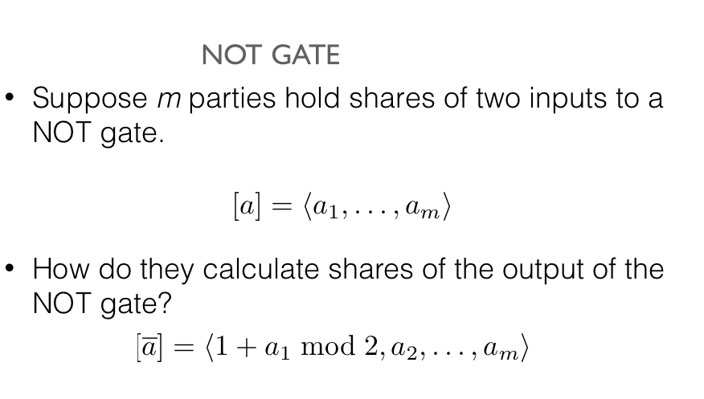
MPC Construction Idea

Slide 31
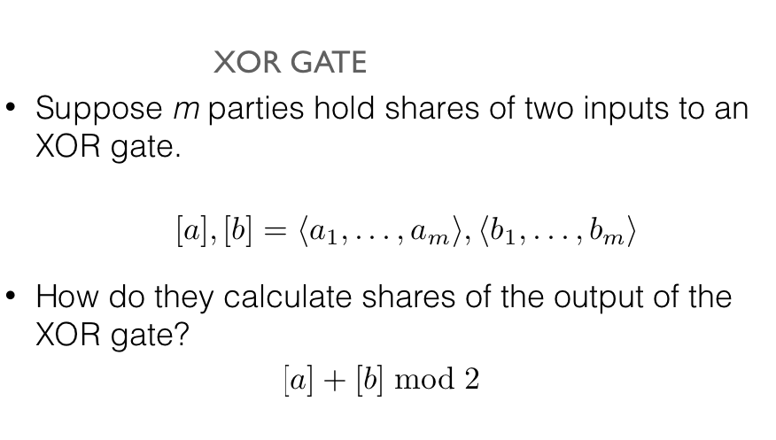
MPC Construction Idea

Slide 32
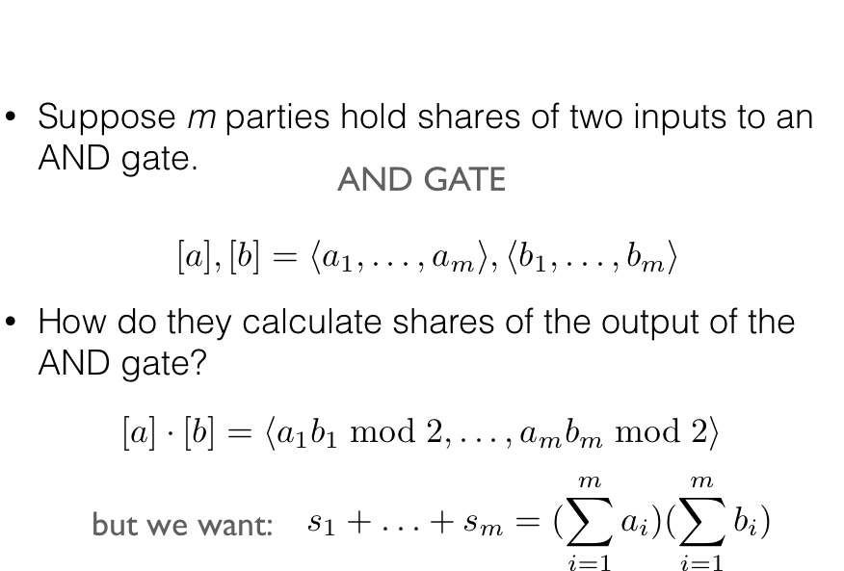
MPC Construction Idea

Slide 33
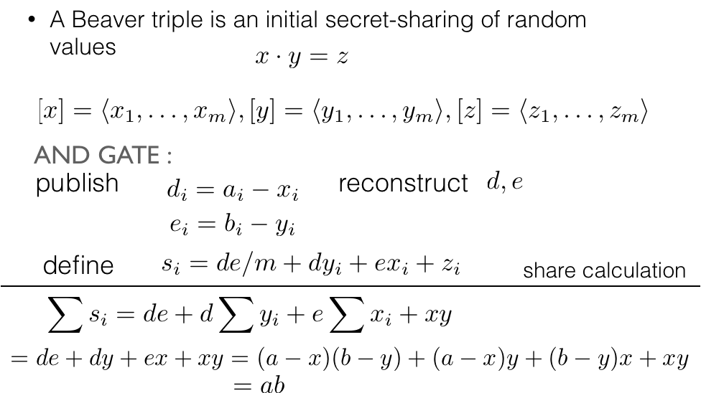

MPC Construction Idea
( assuming m is odd )

Slide 34
Constructing Beaver Triples
The above construction idea requires the setup of all servers with a sufficient number of Beaver triples (how many?)
Constructing Beaver triples can be done via special-purpose cryptographic protocols

Slide 35
MPC strengths and weaknesses
Possible to compute any function f privately on parties’ inputs
Unless honest majority is present, there is no way to provide:
fairness: either all parties learn the output or none
guaranteed output delivery

Slide 36
Fairness

Slide 37
Workarounds for fairness
Optimistic fairness (by involving a third party):
The protocol is basically not fair
A third party is guaranteed to be able to engage and amend the execution in case of deviation
Gradual/timed release:
Protocols engage in many rounds
Parties gradually come closer to computing the output
“gradual closeness” can be measured in terms of:
probability of guessing the output
number of computational steps remaining to compute the output
Example:
At each round l = 1,...,n the two parties can compute the output in 2^{n-l} steps
If a party aborts the interaction, the other party will be 2 times more steps “behind” in the calculation of the output

Slide 38
Using a blockchain
Along the lines of optimistic fairness, but substituting the trusted third party with the blockchain
How is that possible?
Blockchain cannot keep secrets
Rationale: penalize parties that deviate from the protocol

Slide 39
Basic tool: time-lock transactions
Time-lock transactions
part of transaction data
specifies the earliest time that a transaction can be included in a block
Key observation: if a conflicting transaction has already being included in the ledger, the time-lock transaction will be rejected

Slide 40
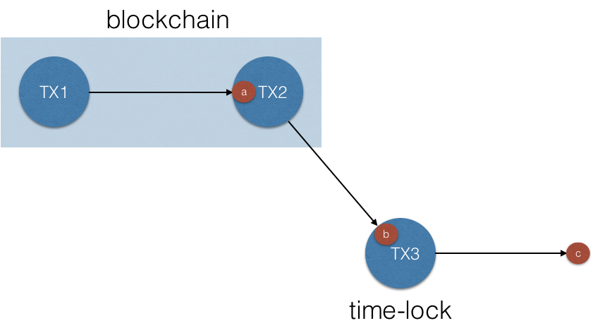
Time-lock example
Transaction
Cannot be included
Before a certain time

Slide 41
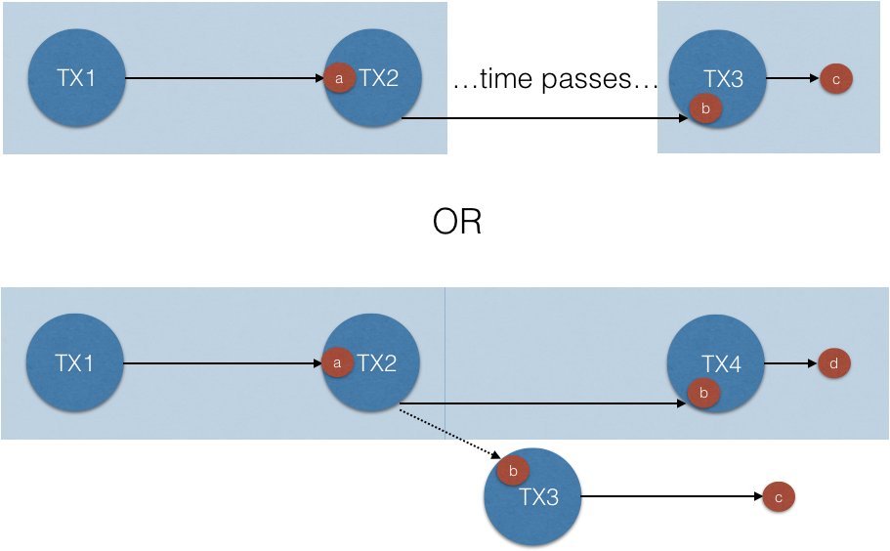
Time-lock example

Slide 42
Fair swap of values using time-locks, Setup
P₁ holds w₁, h₂=H(w₂)
P₂ holds w₂, h₁=H(w₁)
They want to exchange w₁, w₂

Slide 43


Fair swap of values using time-locks, Setup
Value: 5 $
Pay Bob if
two values w1, w2, s.t. H(w1) = h1 and H(w2) = h2
Or P1 and P2 sign, as 2-out-of-2 multisignature
Value: 5 $
Pay Alice if
The value w1 s.t. H(w1) = h1 is provided
Or P1 and P2 sign, as 2-out-of-2 multisignature
TX_{A}
P2SH
TX_{B}
P2SH
Give the money of TX_{A} to
Alice after time t_{A}
TX_{A}’ P2PKH
Give the money of TX_{B} to Bob
After time t_{B}
Refund transactions
using time-locks
TX_{B}’ P2PKH
TX_{A}’
w₁, h₂=H(w₂)
S_{B} TX_{B}’
w₂, h₁=H(w₁)
S_{A}

Slide 44
Fair swap of values using time-locks, Setup
Value: 5 $
Pay Bob if
two values w1, w2, s.t. H(w1) = h1 and H(w2) = h2
Or P1 and P2 sign, as 2-out-of-2 multisignature
Value: 5 $
Pay Alice if
The value w1 s.t. H(w1) = h1 is provided
Or P1 and P2 sign, as 2-out-of-2 multisignature
TX_{A}
P2SH
TX_{B}
P2SH
Give the money of TX_{A} to
Alice after time t_{A}
TX_{A}’ P2PKH
Give the money of TX_{B} to Bob
After time t_{B}
Refund transactions
TX_{B}’ P2PKH
TX_{A}’
w₁, h₂=H(w₂)
S_{B} TX_{B}’
w₂, h₁=H(w₁)
S_{A}
TX_{A}
TX_{B}
Blockchain
w₁
Credit Alice 5$
w₁ w₂
Credit Bob 5$

Slide 45

Fair swap of values using time-locks, Setup
Value: 5 $
Pay Bob if
two values w1, w2, s.t. H(w1) = h1 and H(w2) = h2
Or P1 and P2 sign, as 2-out-of-2 multisignature
Value: 5 $
Pay Alice if
The value w1 s.t. H(w1) = h1 is provided
Or P1 and P2 sign, as 2-out-of-2 multisignature
TX_{A}
P2SH
TX_{B}
P2SH
Give the money of TX_{A} to
Alice after time t_{A}
TX_{A}’ P2PKH
Give the money of TX_{B} to Bob
After time t_{B}
Refund transactions
TX_{B}’ P2PKH
TX_{A}’
w₁, h₂=H(w₂)
S_{B} TX_{B}’
w₂, h₁=H(w₁)
S_{A}
TX_{A}
TX_{B}
Blockchain
w₁
Credit Alice 5$
Credit Alice 5$ (more) after time t_{B}

Slide 46
Fair swap of values using time-locks, Setup
Value: 5 $
Pay Bob if
two values w1, w2, s.t. H(w1) = h1 and H(w2) = h2
Or P1 and P2 sign, as 2-out-of-2 multisignature
Value: 5 $
Pay Alice if
The value w1 s.t. H(w1) = h1 is provided
Or P1 and P2 sign, as 2-out-of-2 multisignature
TX_{A}
P2SH
TX_{B}
P2SH
Give the money of TX_{A} to
Alice after time t_{A}
TX_{A}’ P2PKH
Give the money of TX_{B} to Bob
After time t_{B}
Refund transactions
TX_{B}’ P2PKH
TX_{A}’
w₁, h₂=H(w₂)
S_{B} TX_{B}’
w₂, h₁=H(w₁)
S_{A}
TX_{A}
Blockchain
TX’_{A}
Credit Alice 5$

Slide 47
Fair swap of values using time-locks, Setup
Value: 5 $
Pay Bob if
two values w1, w2, s.t. H(w1) = h1 and H(w2) = h2
Or P1 and P2 sign, as 2-out-of-2 multisignature
Value: 5 $
Pay Alice if
The value w1 s.t. H(w1) = h1 is provided
Or P1 and P2 sign, as 2-out-of-2 multisignature
TX_{A}
P2SH
TX_{B}
P2SH
Give the money of TX_{A} to
Alice after time t_{A}
TX_{A}’ P2PKH
Give the money of TX_{B} to Bob
After time t_{B}
Refund transactions
TX_{B}’ P2PKH
TX_{A}’
w₁, h₂=H(w₂)
S_{B} TX_{B}’
w₂, h₁=H(w₁)
S_{A}
TX_{A}
TX_{B}
Blockchain
TX’_{B}
Credit Bob 5$

Slide 48
Fair swap of values using time-locks, Execution
P₁:
Creates a P2SH transaction TX for $X provided that:
(P₁ and P₂ sign, as 2-out-of-2 multisignature) or
(P₂ signs and reveals w₁, w₂, s.t. H(w₁) = h₁ and H(w₂) = h₂)
Creates a P2PKH transaction TX’ that spends the output of TX with a time-lock in the near future
Sends TX’ to P₂ to sign it (P₂ does not see TX, only the tx id is needed to refer to it)
P₂ acts in the same way:
Create a TX that can be redeemed via (2-out-of-2 multisig) or (P₁ signs and reveals w₁, s.t. H(w₁)=h₁)
Create a corresponding time-locked TX’ and send to P₁ to sign
Completion:
P₁ publishes its TX, so P₂ can redeem $X by revealing w₁, w₂
P₂ publishes its TX, so P₁ can redeem $X by revealing w₁
P₁ reveals w₁ and redeems $X (from P₂’s TX)
P₂ reveals w₁, w₂ and redeems $X (from P₁’s TX)
If either party aborts, the other can claim $X (from their TX) after time-lock fires, by publishing their TX’
Pay to script hash (P2SH)
Pay-to-Public-Key-Hash (P2PKH)

Slide 49
Fair swap of values using time-locks, Notes
If P₁’s TX could be redeemed by “H(w₂) = h₂ and P₂ signs it”:
P₂ could reveal w₂ and obtain payment of $X, without publishing its own TX transaction
P₁ would obtain the output w₂ but lose $X
(note that we cannot ensure that the TX transactions will appear concurrently in the blockchain)
If a multisig was not used for the refunds, a player could:
Submit its value
Rush to obtain its refund, invalidating the TX payment of the other player
The time-lock for P₁ should be less than that for P₂; if equal, P₁ could:
Wait for the very last minute to reveal w₁
Hope that time-lock fires before P₂ can publish w₂ on the chain
Claim $X even if P₂ tries to act honestly (and reveals w₂ out of time)

Slide 50
Fair Computation
The two parties use MPC to compute a secret sharing of the output of the computation
w₁ + w₂ = MPC_output
Subsequently parties do a fair swap of values, to obtain the MPC_output:
If a party aborts, the other will be compensated

Slide 51
N-party ladder construction, I
Uses N-out-of-N multisig for refunds
P_{N} can redeem $X from each player if it reveals w₁, w₂, …, w_{N} (i.e., the N-1 parties prepare these “roof” TX transactions)
For i = 1, …, N-1, player P_{N-i} can redeem from player P_{N-i+1} an amount equal to $X(N-i) if it reveals w₁, w₂, …, w_{N-i} (the N-1 parties also prepare these “ladder” TX transactions)
Redeeming follows the sequence P₁, P₂, …, P_{N}

Slide 52
N-party ladder construction, II
P₁ will redeem $X from P₂ for publishing w₁
P₂ will redeem $2X from P₃ for publishing w₁, w₂
…
P_{N-1} will redeem $(N-1)X from P_{N} for publishing w₁, w₂, …, w_{N-1}
P_{N} will redeem $X from each of P₁, …, P_{N-1} for publishing w₁, w₂, …, w_{N}
Note before P_{N} acts, P₁ is at $X, P₂ is at -$X+$2X =$X, P₃ is at -$2X+$3X =$X, etc.

Slide 53
References
For secret sharing and multi-party computation in general, look at Chapter 3, until Section 3.3.2 of the following book (you can access to the book with your university account.
Cramer, R., Damgård, I., & Nielsen, J. (2015). Secure Multiparty Computation and Secret Sharing. Cambridge: Cambridge University Press. doi:10.1017/CBO9781107337756.
For fair swap, and in particular for how to achieve fairness with compensation in multi-party computation, please look at this paper and follows the references when something is not clear.
Marcin Andrychowicz, Stefan Dziembowski, Daniel Malinowski, and Lukasz Mazurek. Fair two-party computations via the bitcoin deposits. In 1st Workshop on Bitcoin Research 2014 (in Assocation with Financial Crypto), 2014. http://eprint.iacr.org/2013/837.

